Slide 1
Implementing Turtle Braille One Pixel at a Time
A tool to help the blind "see" simple graphics

Slide 2
Introduction
Presentation Goal
Demonstrate shadowing turtle module, adding features for the blind
Tool Goal
For the blind, access to simple graphics

Slide 3
Background
I'm a programmer / teacher
Graphics / Pictures are helpful
Blind have limited access to graphics

Slide 4
The Tool
An aid, for the visually impaired beginning programmer, to help in "seeing" the graphical output produced by simple programs

Slide 5
Using just turtle - draw a square
# square_loop_colors_std.py
# Display a square different color each side
from turtle import * # Using standard library
width(40) # Widen square edges
colors = ["red","orange","yellow","green"]
for colr in colors:
color(colr) # Give side this color
forward(200)
right(90)
done() # Complete drawing
Notes:
Turtle Graphics a part of the Logo programming language
Developed by Wally Feurzeig, Seymour Papert and Cynthia Solomon in 1967 MIT
We don't like possible confusion by re-using turtle.py name.

Slide 6
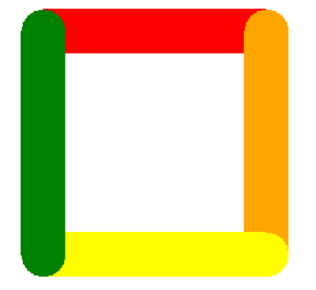
Using turtle – graphic output
Notes:
We don't like possible confusion by re-using turtle.py name.

Slide 7
Using tool - draw a square
# square_loop_colors_std.py
# Display a square different color each side
from turtle_braille_link import * # our code
width(40) # Widen square edges
colors = ["red","orange","yellow","green"]
for colr in colors:
color(colr) # Give side this color
forward(200)
right(90)
done() # Complete drawing
Notes:
We don't want possible confusion by re-using turtle.py name.

Slide 8
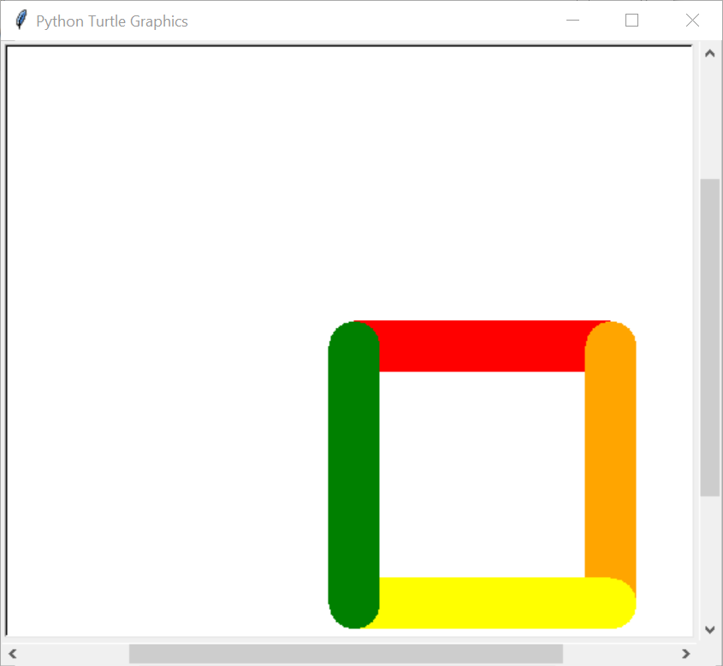
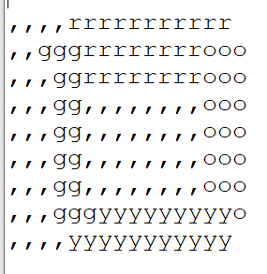
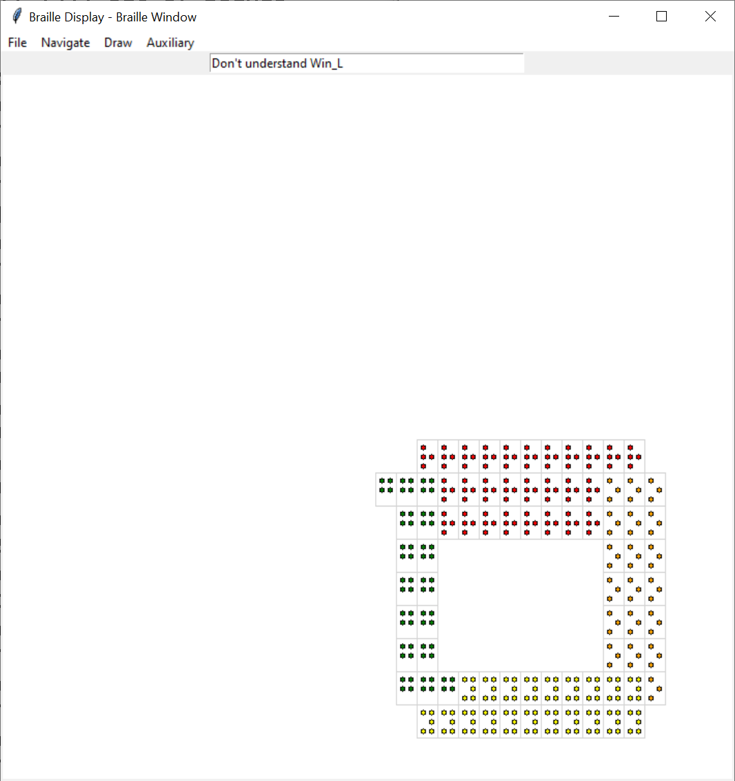
Tool Output → +Text picture, +Audio feedback
Notes:
Braille display widow started as a guide to the implementor
Became an audio based guide

Slide 9
The Plan
Braille rendition of simple Turtle graphics
A text picture to send to the embosser
Coarse – 30 to 40 characters by 25 lines
One color letter per square

Slide 10
The Plan continued…
Run turtle code
Scan tkinter.Canvas created
Look at each of 40 by 25 regions
display regions with overlapping Canvas items

Slide 11
Obtaining Turtle screen
Only ONE turtle call captured:
done()
Obtain turtle's tkinter.Canvas
Scan cell regions for overlapping
Do displays
Notes:
Predates python

Slide 12
Control code snippets
class BrailleDisplay:
def __init__(self, …args):
…setup
self.tu_screen = tur.Screen()
def done(self): # called by user's program
self.mainloop()
def mainloop(self):
self.display(title=title,…args)
Notes:
Predates python

Slide 13
BrailleDisplay continued
…
def display(self, …args):
…setup
tu_canvas = self.tu_screen.getcanvas()
self.canvas_grid = CanvasGrid(master=mw,
base=tu_canvas,…more args)
…
self.aud_win = self.canvas_grid.create_audio_window(
title=tib)
Notes:
Predates python

Slide 14
Scanning code snippets
class CanvasGrid(tk.Canvas):
def __init__(self, master, base=None,
…more args, **kwargs):
if base is None:
base = self
self.base = base
…

Slide 15
CanvasGrid continued
Instances of using the base canvas
In our case, that is Turtle's canvas
cx1,cy1,cx2,cy2 = self.get_grid_ullr(ix=ix, iy=iy,
xs=xs, ys=ys)
item_ids_over_raw =
self.base.find_overlapping(cx1,cy1,cx2,cy2)
…
color_tuple = self.base.itemconfigure(top_id,
"fill")
Notes:
self.base references the tkinter.Canvas populated by turtle actions

Slide 16
Finding canvas items that overlap grid regions CanvasGrid continued
def get_canvas_items(self, xmin=None, xmax=None, ymin=None, ymax=None, ncols=None, nrows=None, … other parameters): # Get grid limits - defaulting to self.values xs,ys = self.get_grid_lims(xmin=xmin, xmax=xmax, ymin=ymin,ymax=ymax, ncols=ncols,nrows=nrows) ixy_ids_list = [] # Building list of # ((ix,iy), [overlapping # ids])

Slide 17
CanvasGrid get_canvas_items continued
… debug / tracking statements for ix in range(len(xs)-1): for iy in range(len(ys)-1): cx1,cy1,cx2,cy2 = self.get_grid_ullr(ix=ix, iy=iy, xs=xs, ys=ys) item_ids_over_raw = self.base.find_overlapping( cx1,cy1,cx2,cy2) if len(item_ids_over_raw) == 0: continue # Skip - no overlap

Slide 18
CanvasGrid get_canvas_items continued
… code for selection on item type if chosen: item_ids_over.append(item_id) if len(item_ids_over) > 0: ixy_ids_list.append(((ix,iy), item_infos_over)) return ixy_ids_list

Slide 19
Display window with audio feedback
Braille Picture was OK – but slow
Displays Braille picture with:
User navigation (cursor keys, mouse)
Speech description of location/color
Audio tones – faster yet response

Slide 20
Audio Feedback continued
Voice – uses pyttsx3 speech to text module
Tones – github: daviddavini/pysinewave
pysinewave_master – PYPI: not new enough
async, stereo
Added simple drawing facility

Slide 21
Previous strategy for display cells worked
By
Create sample points for ALL shapes created
Getting display regions in which points found
but we had to…
"shadow functions" for ALL turtle commands used
Lots of Turtle "reverse engineering"
No support for tkinter programs

Slide 22
Future Possibilities
Navigational Improvements
Stereo audio feedback, distance, direction, feedback
Presentation Improvements
Real-time scaling region magnification / selection

Slide 23
Lessons Learned / Relearned
No substitute for feedback
Users - recognize what they like
Developers - knows what can be done

Slide 24
Source Code
GitHub Project github.com/raysmith619/resource_lib
src/ – source files (all Python)
README.md – Short description

Slide 25
Question and Answer

